Slide 1
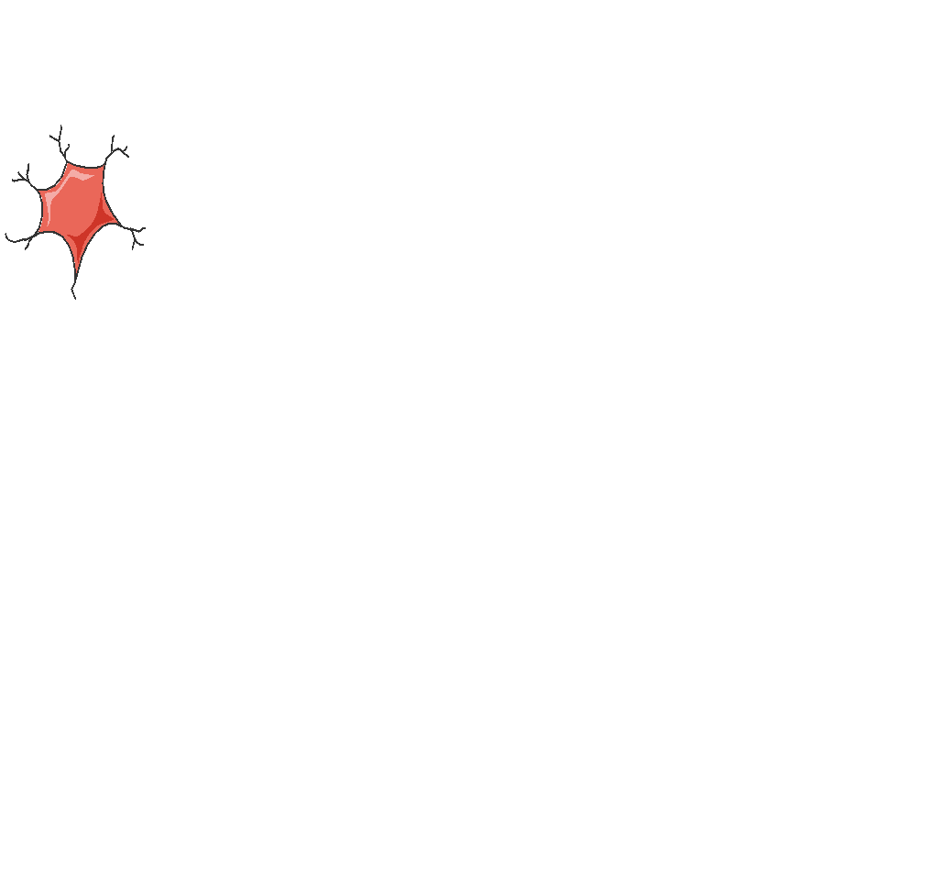
Defragmentation Training School
NEUBIAS Academy & EOSC-Life 2022
21st of October 2022
Group 1 :
Anna Kotova
Camille Loiseau
Daniel Waiger
Gayathri Nadar
Tatiana Woller

Slide 2



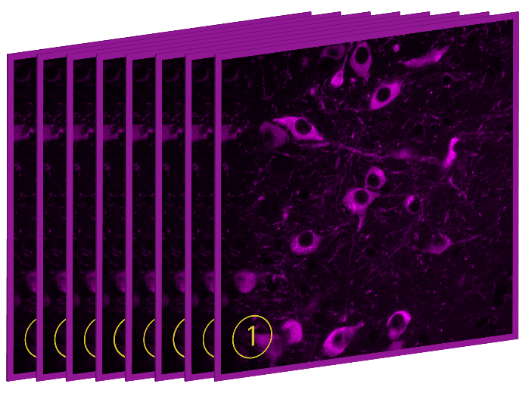
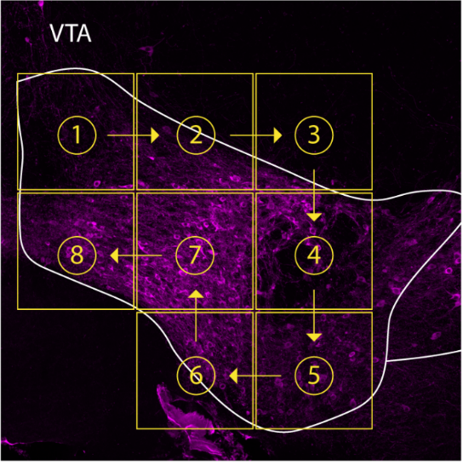

Imaging strategy
Sections containing my brain structure of interest: VTA
Sections containing my brain structure of interest: VTA
line 1
Perfused and processed for IF:
TH / LC3 / pSyn
mice id
lame 1
line 2
mice
section 1
section 2
section 3
section …
line 3
X40 single-plane
confocal images
X10 tile scan to get an overview of the ROI

Slide 3
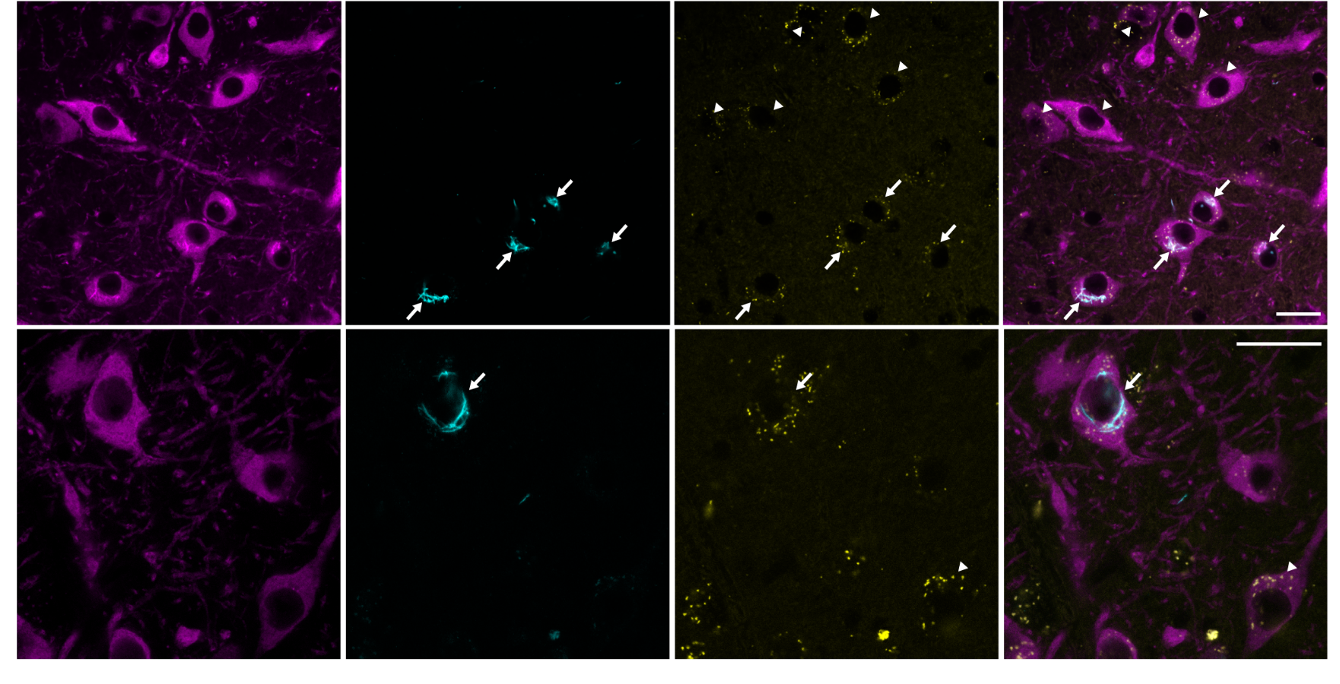
Macroautophagy pathway
TH
pSyn
LC3
merge
20µm
20µm
TH
pSyn
LC3
merge

Slide 4
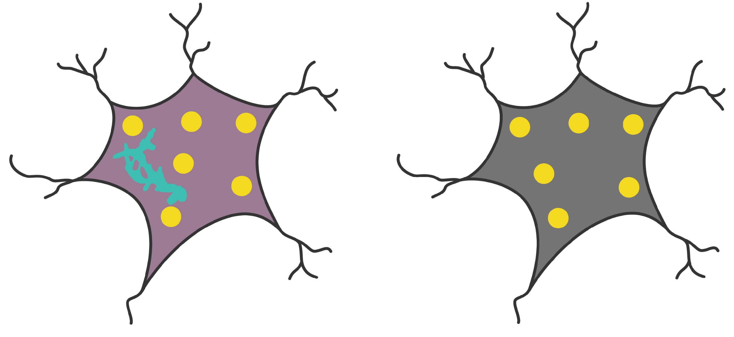
Scientific question
LC3
LC3
psyn
TH neuron
TH neuron
sick neuron
healthy neuron

Slide 5
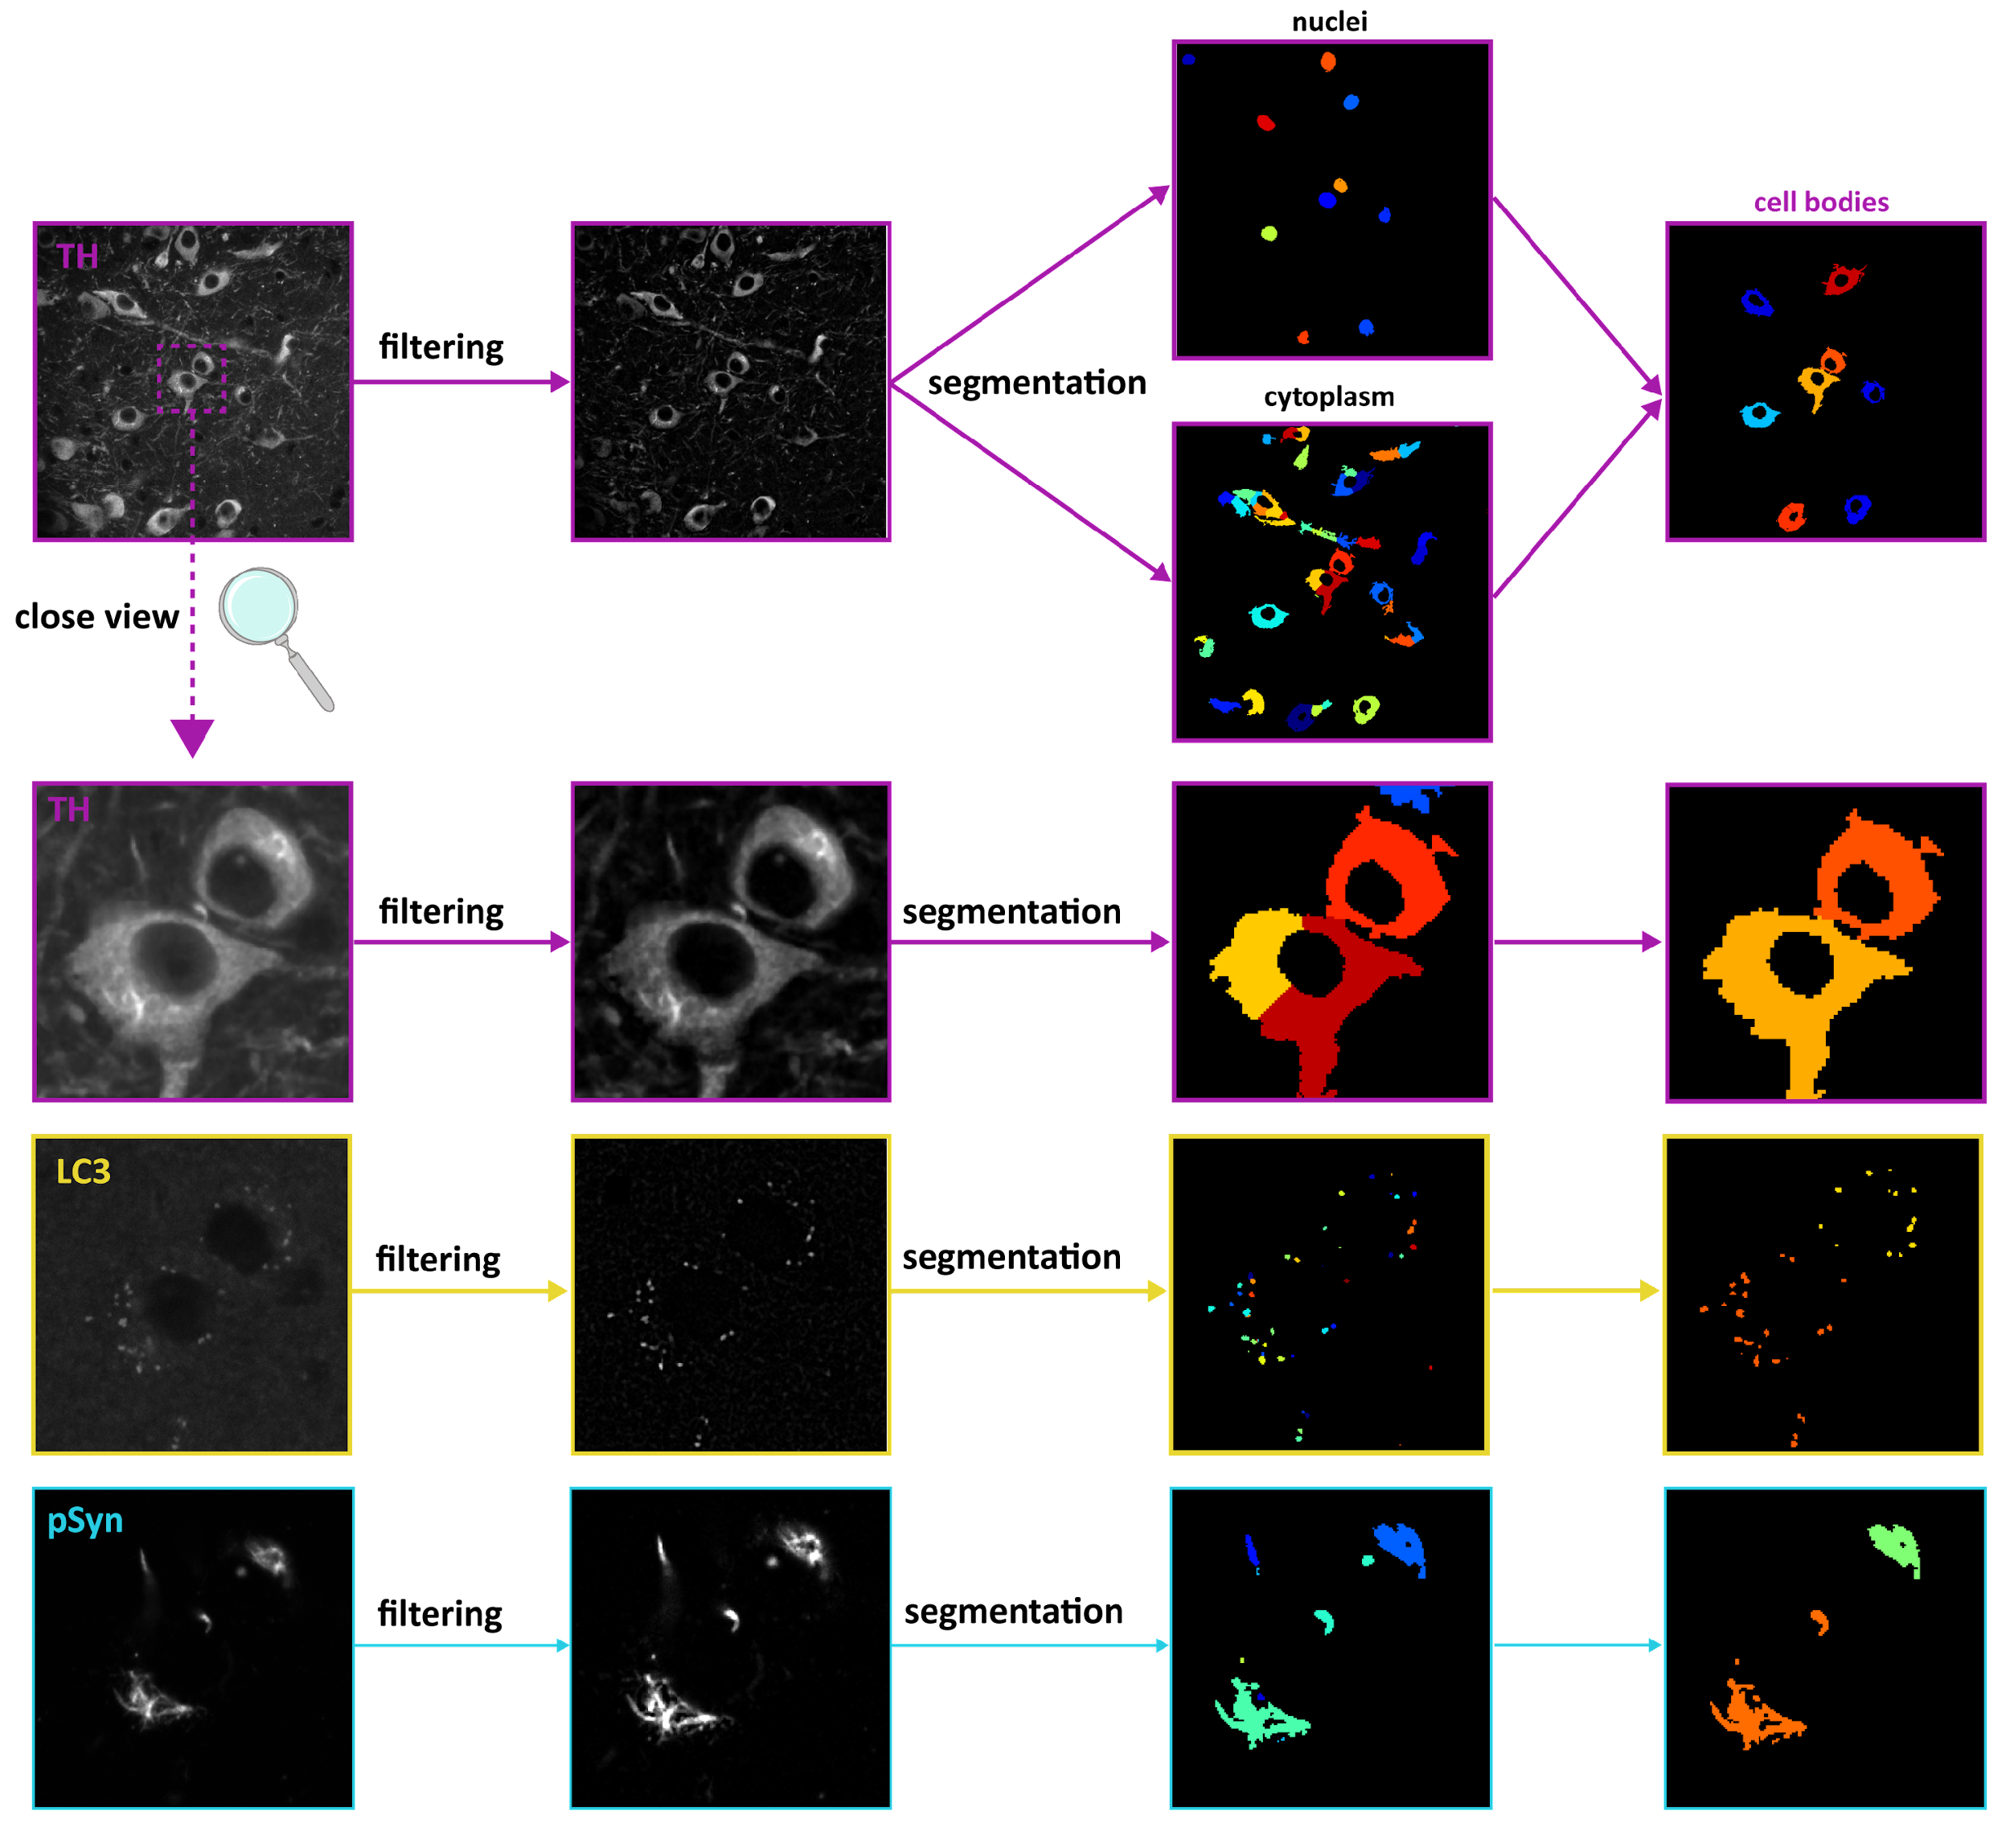

Slide 6
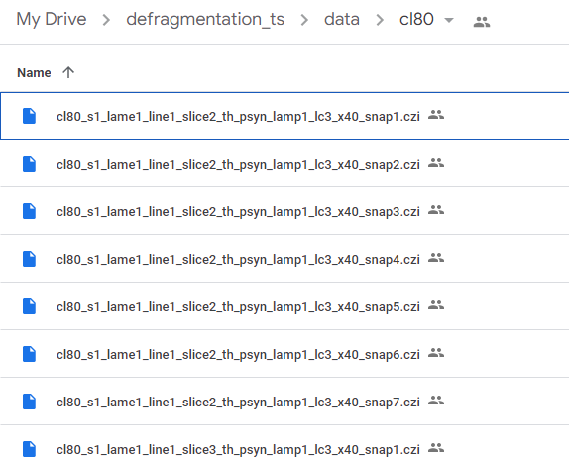
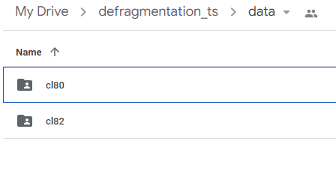
Data set and File name
cl80 and cl82
Series number
What is in the different channels
image number
cl80_s1_lame1_line1_slice2_th_psyn_lamp1_lc3_x40_snap1.czi
Location of the section
extension
mice id
Magnification

Slide 7
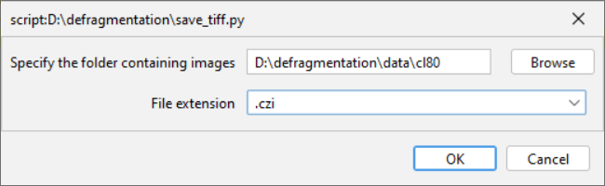
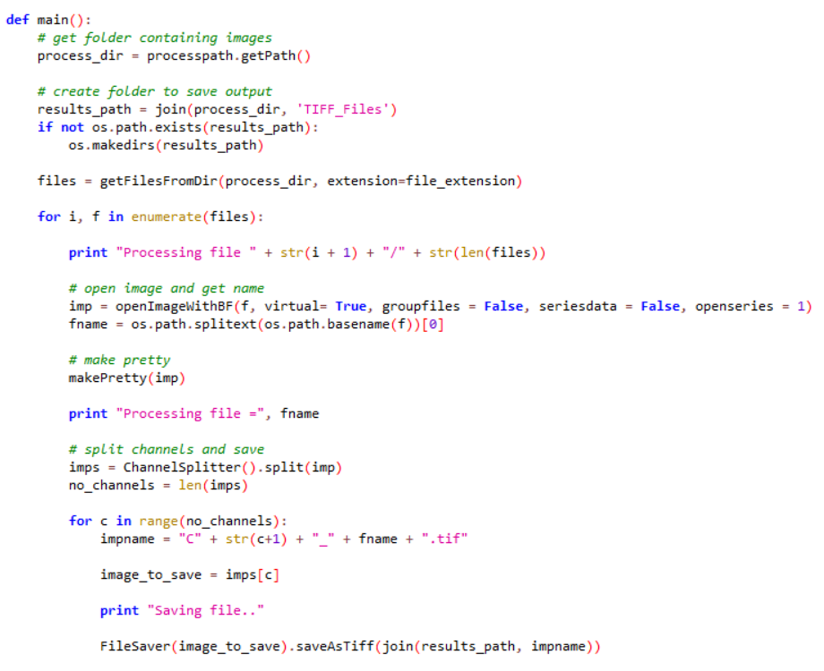
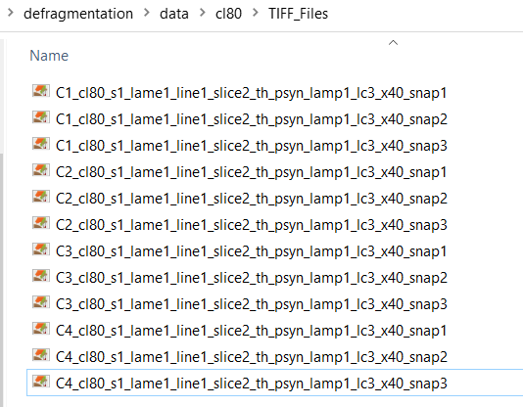
Data Preparation using FIJI Script
Create an output folder next to input folder automatically
Read files from folder and process in a loop. We open the image using Bio-Formats. Custom functions for each step.
Adjust Brightness/Contrast. Does it on each channel. Custom function.
Split channel, name it properly, save to output location.
Notes:
Optional slide

Slide 8
Challenges
We wanted to have a notebook that runs an elaborate workflow, like jupyter or a collab, and use DL/ML platforms to do the job.
And… with a minimal number of steps in the segmentation part.

Slide 9
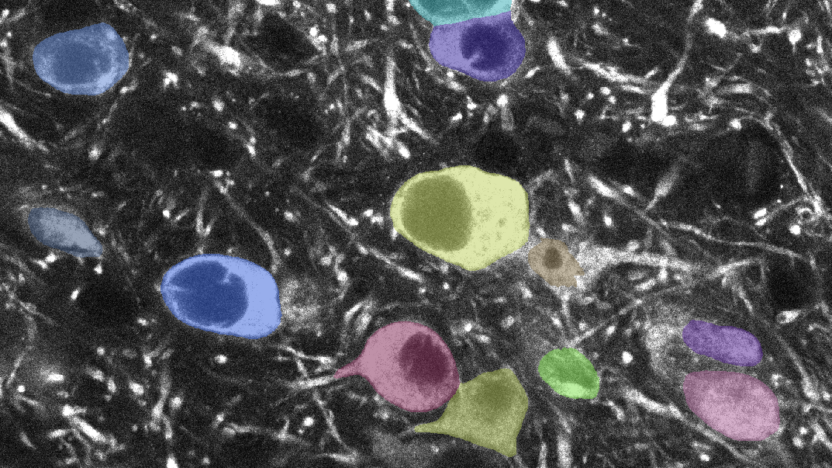

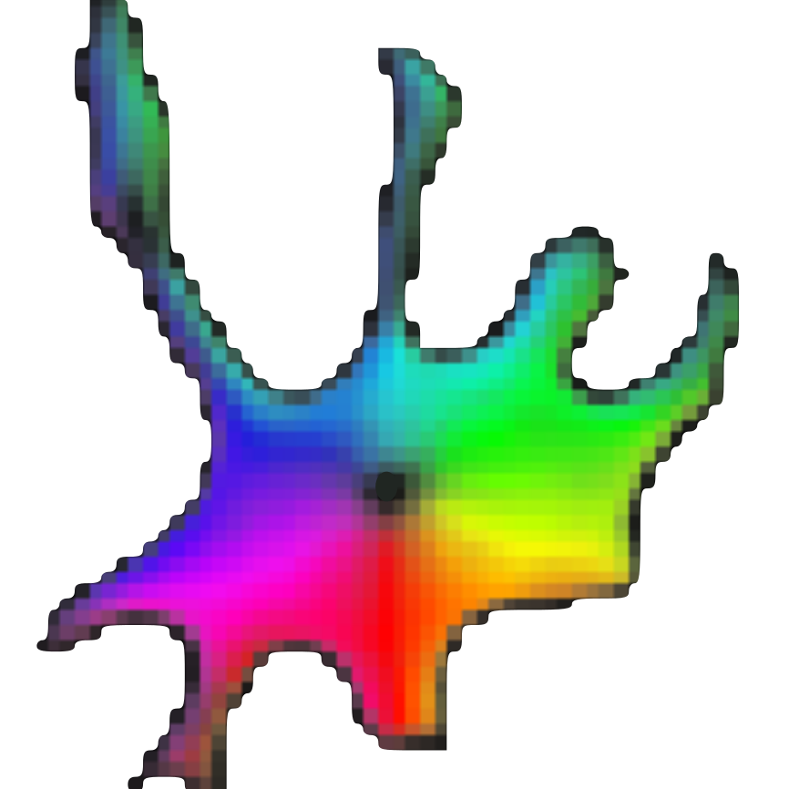


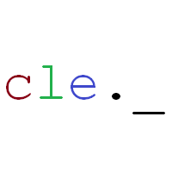
Cellpose
So, we thought, why not run ilastik in napari?
Then, we decided that a trainable ML solution should be used.
unfortunately ilastik doesn’t with notebooks, yet (Ilastik trained model in Jupyter notebook + GPU - Image.sc Forum, 2019; Ilastik *experimental* api - Image.sc Forum, Sep-2022).
Our aim is to detect the cytoplasm w/o the nucleus
But, little did we know…
./merde.log
It crashed every time we started training the classifier

Slide 10
Napari
- Fast, interactive, multi-dimensional image viewer for Python
- Performant GPU-based rendering
- Coupling to machine learning and image analysis tools
(scikit-learn,scikit-image, TensorFlow, Pytorch)
- User-friendly (Plugins) and reproducible (Jupyter notebook as output)
https://napari.org/stable/

Slide 11
Napari
- Fast, interactive, multi-dimensional image viewer for Python
- Performant GPU-based rendering
- Coupling to machine learning and image analysis tools
(scikit-learn,scikit-image, TensorFlow, Pytorch)
- User-friendly (Plugins) and reproducible (Jupyter notebook as output)
https://napari.org/stable/

Slide 12
Napari-Accelerated Pixel and Object Classifiers (APOC)
Clesperanto and scikit-learn for pixel & object classification in images
Interactive plugin from napari viewer or from a jupyter notebook
haesleinhuepf/napari-accelerated-pixel-and-object-classification at 0.10.2 (github.com)

Slide 13
Napari-Accelerated Pixel and Object Classifiers (APOC)
Input: one image with manual annotations
Training of an object segmenter based on Scikit_learn random forest classifier
haesleinhuepf/napari-accelerated-pixel-and-object-classification at 0.10.2 (github.com)

Slide 14
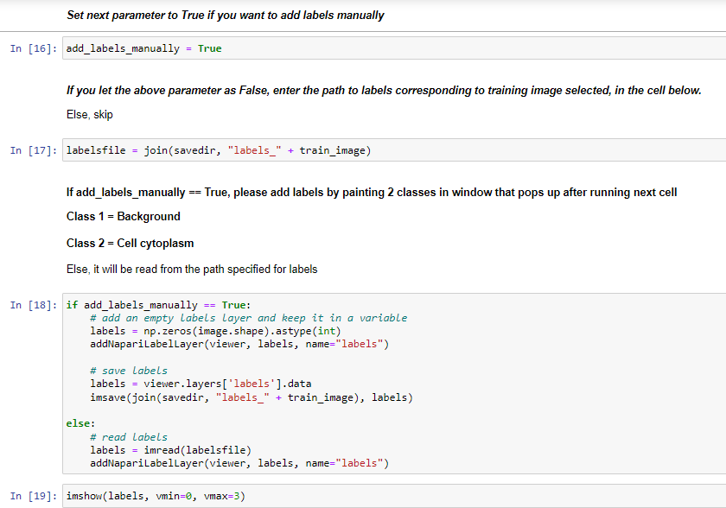
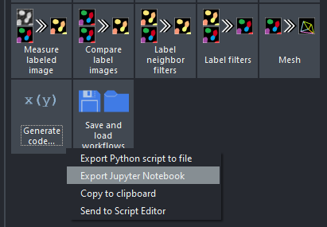

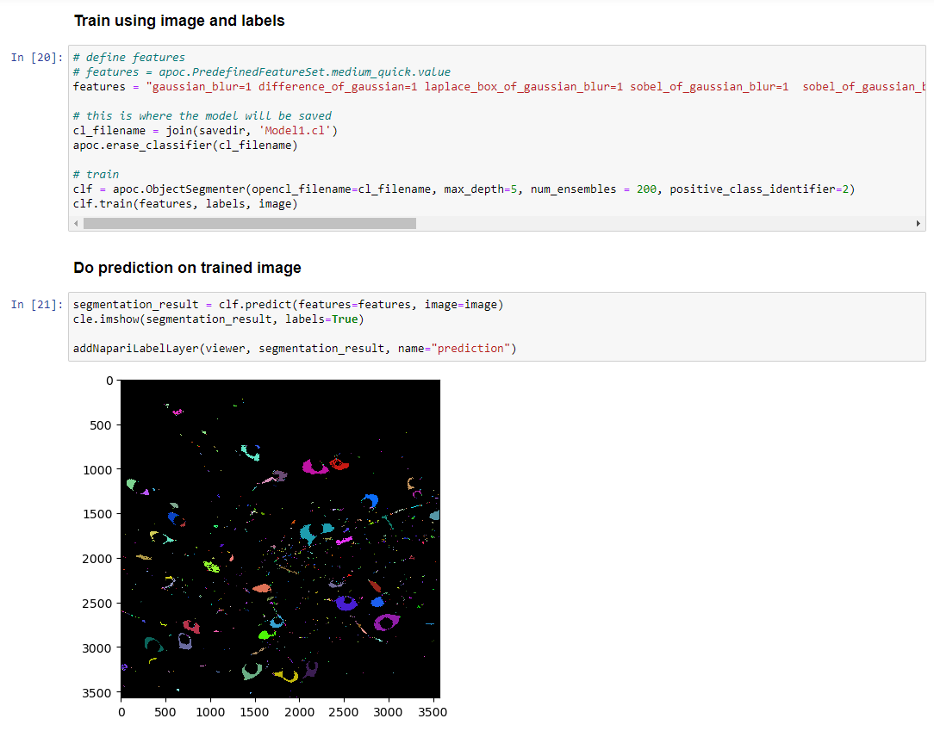
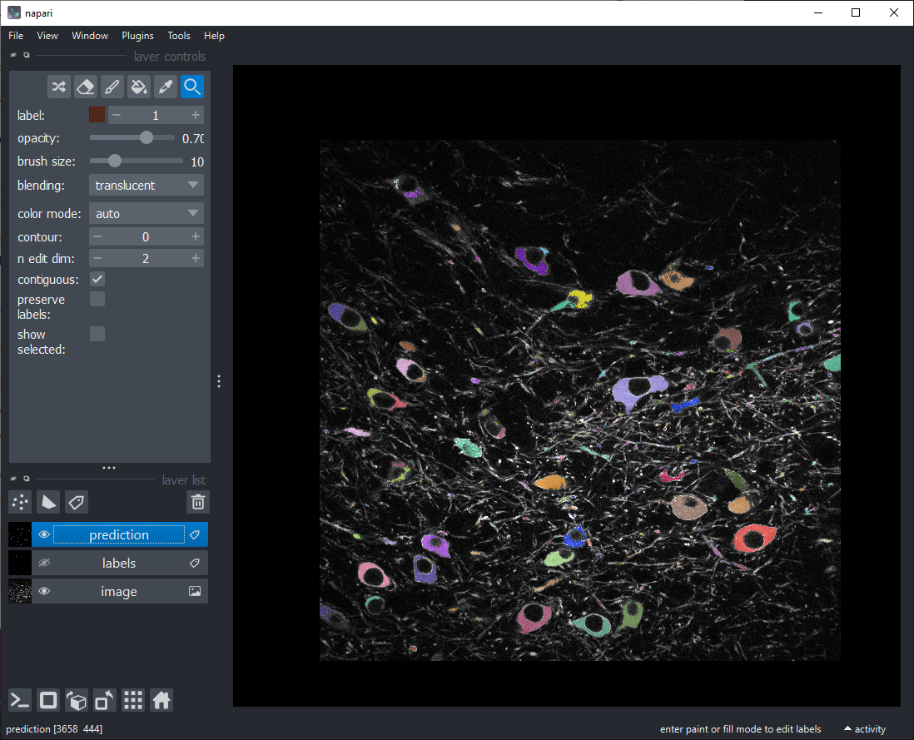
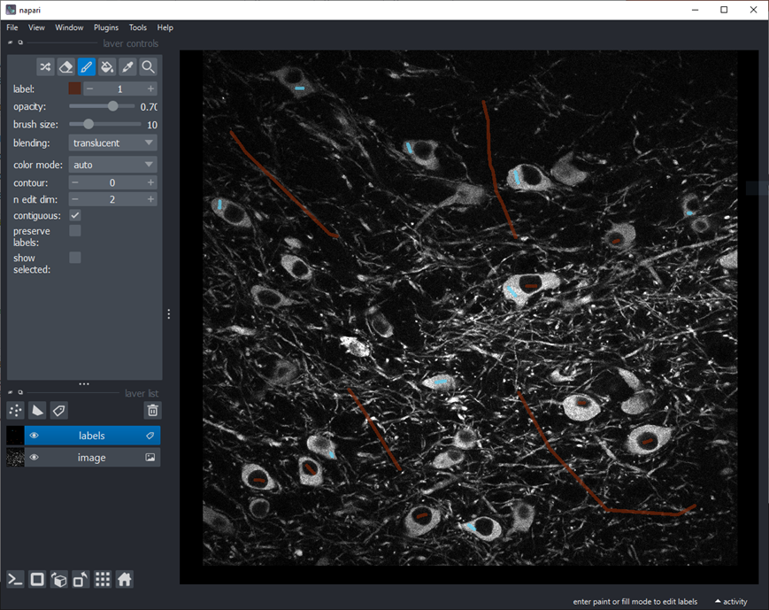
APOC Workflow using Napari and Jupyter Notebooks
Napari Assistant
Jupyter Notebook
Run locally
Accelerated Pixel and Object Classification workflow
2 labels – background & cytoplasm
Export Jupyter Notebook
Tailored notebook to our data
Custom functions
Add labels interactively by launching napari via jupyter
Train classifier and save to disk
haesleinhuepf/apoc (GitHub)

Slide 15
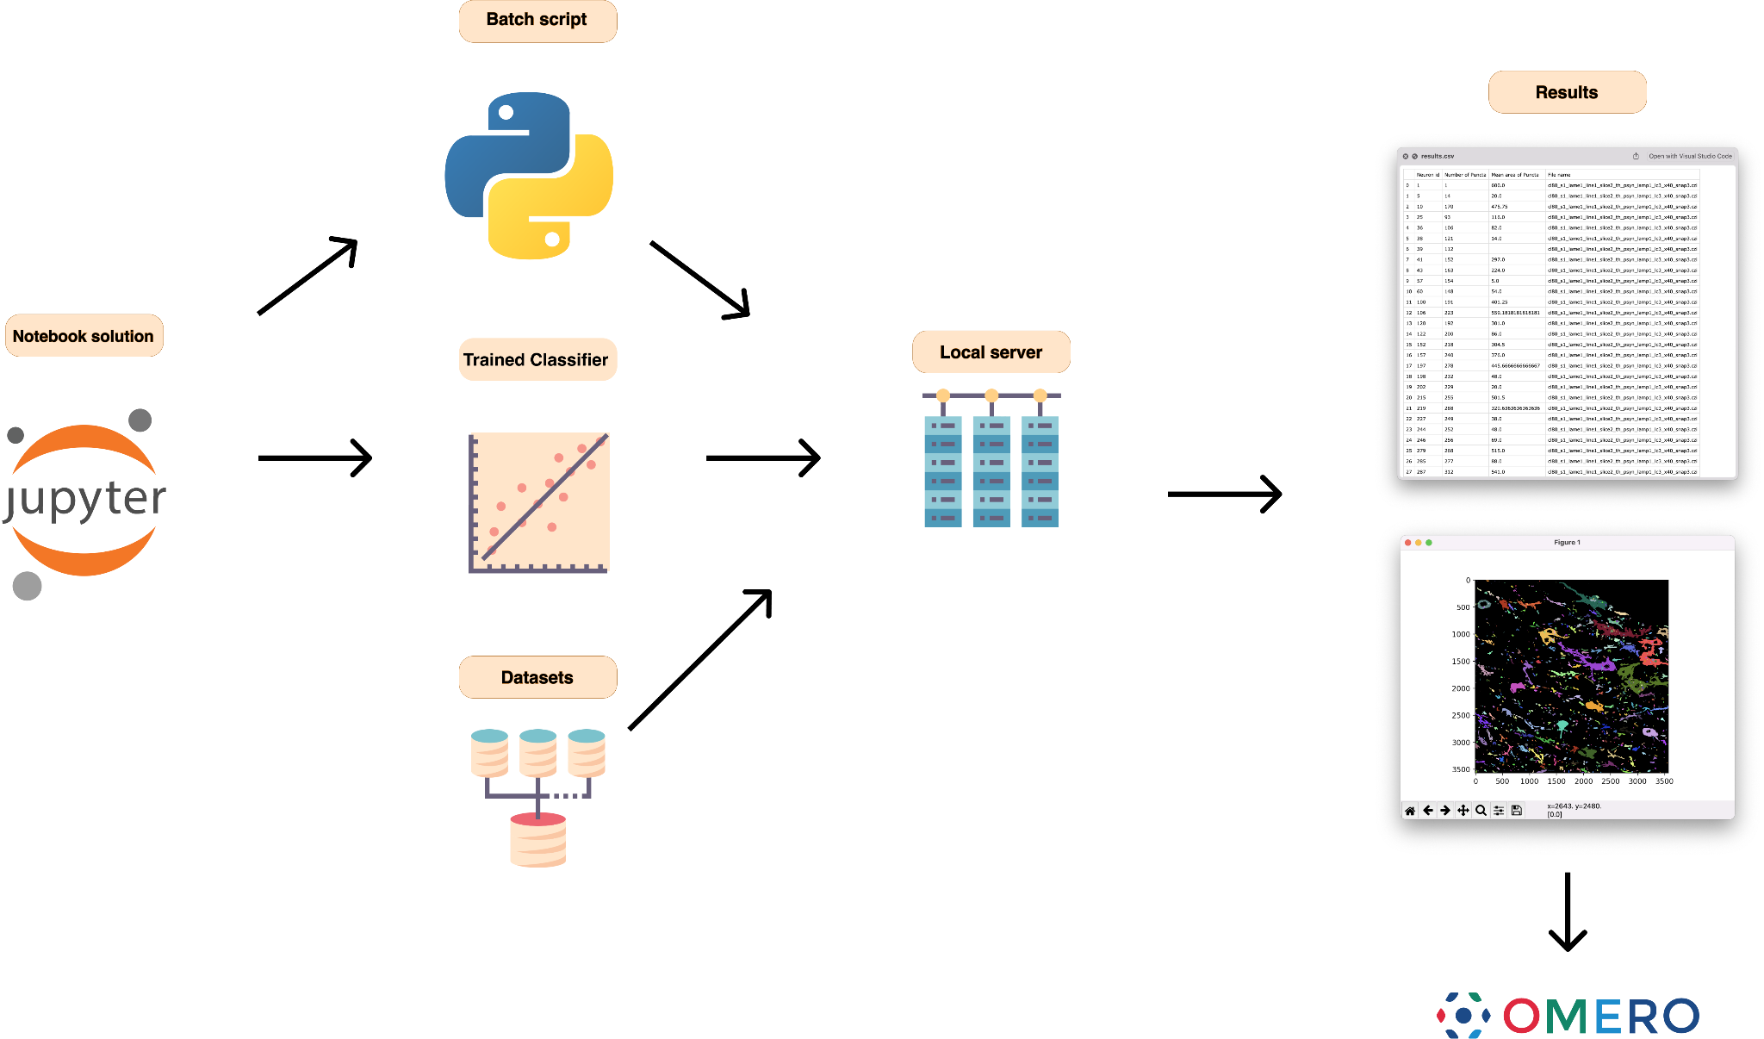
Converting to batch solution

Slide 16
Thank you for your attention!

